Slide 1

Vivekanand Education Society’s Institute Of Technology
Department Of Information Technology
Project Review
Sem: VI Academic Year : 2023 - 24
Title: Airline Satisfaction
Group Members:
30 - Shubham Kamodkar
37 - Mikil Lalwani
44 - Aditi Miniyar
Mentor Name: Ms. Bincy Ivin

Slide 2
Content
Introduction
Problem Statement
Objective of the project
Functionalities
Literature Survey
Requirements of the system (Hardware, software)
Architecture diagram of the proposed system
Expected output
Future Scope
Conclusion
References in IEEE format

Slide 3
Introduction
As with most industries, it can be a head-scratcher as to why customers choose a competing airline over yours and vice versa.
For this reason, airline passenger satisfaction surveys can be a great asset to understanding consumer experiences, expectations, behaviors, and more.
An airline passenger satisfaction survey refers to a type of market research that gathers feedback and information from passengers who have completed a trip with your airline or at your airport.
Typically, a survey is sent a short while after the trip in an effort to learn more about the passenger’s flying experience.
r Rates

Slide 4
Problem Statement
The dataset for this project is obtained from Kaggle which contains the data sourced from a survey conducted by airlines on the satisfaction level of passengers/customers based on various factors.
The dataset consists of 25 columns such as Age, Gender, Travel class, Arrival and Departure delays and also features that influences customer satisfaction level such as On-board service, Cleanliness, Seat comfort, Baggage handling etc.
The dataset consists of a column or feature named ‘satisfaction’ which describes the overall satisfaction level of the customer. It has two values, ‘neutral or dissatisfied’ and ‘satisfied’.
This satisfaction feature is considered as the label feature.
r Rates

Slide 5
Objective of the project
The objectives of this project are as follows:
The objective or goal of this project is to create a platform for airlines company to determine the important factors that influences the customer or passenger satisfaction.
These factors and surveys are important for the growth and reputation of a company.
This prediction would help the airline company to take right decisions towards customer service. This will be done by analysing the results.
r Rates

Slide 6
Functionalities
An airline satisfaction system can provide a variety of functionalities to enhance customer satisfaction and improve the overall experience of flying:
Feedback collection: The system can enable customers to provide feedback on their experiences with the airline, including their flight experience, ground services, staff interactions, and more.
Personalization(company): Based on customer reviews, the system can decide personalized recommendations for flight upgrades, in-flight services, and other amenities.
Loyalty rewards: The system can track the customers that are loyal and provide rewards and benefits for frequent flyers, such as priority boarding, free baggage, and lounge access.
Analytics and reporting: The system can provide airlines with detailed analytics and reporting on customer satisfaction levels, operational efficiency, and other key performance indicators, enabling them to make data-driven decisions.

Slide 7
Literature Survey
Airline satisfaction has been identified as an important topic for many airline companies. As well as it has been a important prediction prototype for academics.The airline satisfaction prediction focuses on understanding the factors that contribute to customer satisfaction and loyalty in the airline industry.
There are multiple findings that have been done on these type of prediction models. The findings are the conclusion of using the model and the responses obtained from using the model. The findings are based on customer reviews, and these reviews help the company to identify whether they are doing good in their field and are the customers satisfied with what they provide.
[1] Hosseini, S., & Ansari, S. (2019). Airline customer satisfaction prediction using machine learning algorithms. Transportation research part C: emerging technologies, 107, 282-296.
It also helps the company to make any necessary changes in the type of services they provide or the service itself that they provide. Bad review and using the prediction model helps them identify any improvements that could be made and what the customers expect.

Slide 8
Literature Survey
One of the finding of this prediction model was service quality. Service quality has consistently been identified as a key factor in airline satisfaction. Studies have found that customers are most satisfied when they perceive the airline as providing high-quality service, including friendly and responsive staff, comfortable seating, and efficient operations.
Another finding from the literature survey of airline satisfaction is Price. Price is another important factor in airline satisfaction, with many customers seeking affordable fares and value for money. This means, that customers are always willing to pay a greater amount for best services and a comfortable travel. Studies have also found that customers are often willing to pay more for airlines that offer superior service and reliability. Thereby, customers don’t choose airlines on basis of money but on the basis of services they enjoy and the type of travel they have.
[2] O'Neill, M., & Palmer, A. (2020). Predicting passenger satisfaction: An examination of airline websites and online reviews. Journal of Air Transport Management, 82, 101774.
Literature survey also showed that loyalty programs have been found to be effective in increasing customer satisfaction and loyalty. Studies have found that customers who are members of loyalty programs are more likely to book with the same airline in the future and to recommend the airline to others.

Slide 9
Literature Survey
Thereby, as loyal the customers more he will prefer the same airline and is also expected to suggest this to others.
Other findings include technology and customer service. Advances in technology have played a major role in airline satisfaction, with customers increasingly expecting convenient and efficient booking, check-in, and in-flight services. Studies have found that airlines that invest in technology and offer a seamless digital experience can significantly enhance customer satisfaction. Customers tend to choose the flight that have better digital space.
Customer service has also been identified as a key factor in airline satisfaction, with customers valuing helpful and friendly staff who are able to quickly resolve any issues or complaints. Customers loved their travel and experience when in flight attendees were good and respectful to them. The way the flight crew behaves with the customers plays an important role in the airline satisfaction review.
Overall, these studies suggest that airline satisfaction is driven by a range of factors, including service quality, price, loyalty programs, technology, and customer service. Airlines that prioritize these factors and invest in enhancing the customer experience are more likely to achieve higher levels of satisfaction and loyalty among their customers.

Slide 10
Requirements of System
Hardware
Storage | 1 GB
Ram | 2 GB Ram
CPU | Intel® Core™ i3 processor
Operating System | Windows 8 or later, macOS, and Linux

Slide 11
Requirements of System
Software
Frontend | Streamlit
Code Editor | Visual Studio Code
Environment | Google Colab, Jupyter Notebook, Kaggle notebook
Operating System | Windows, Linux, MacOS

Slide 12
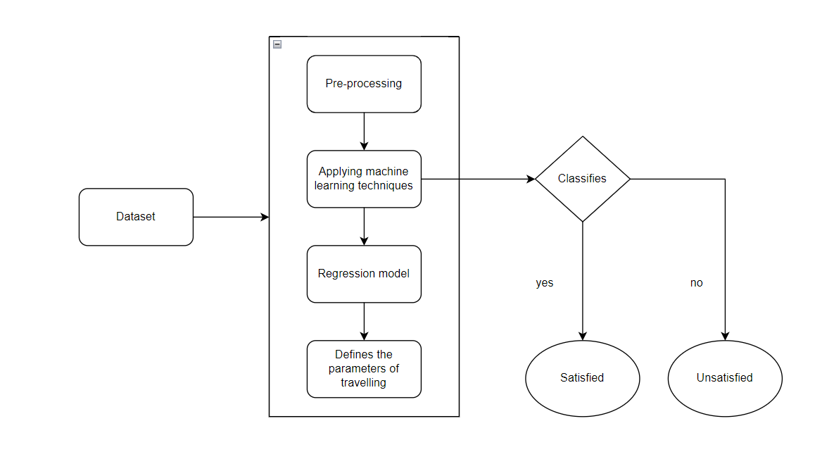
Architecture of Proposed System

Slide 13
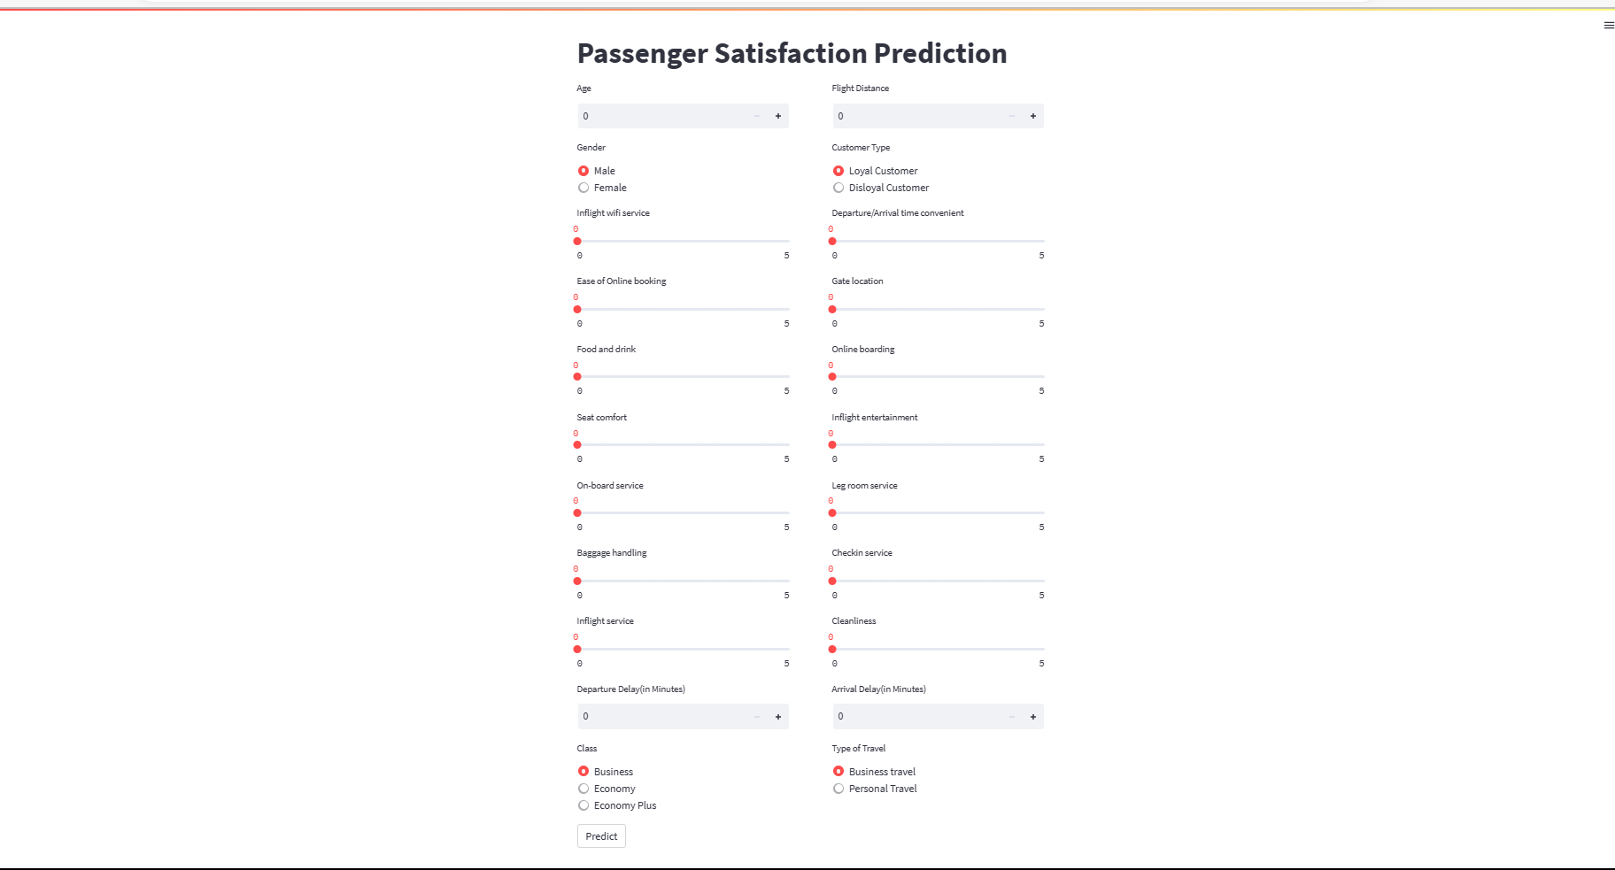
Expected Output

Slide 14
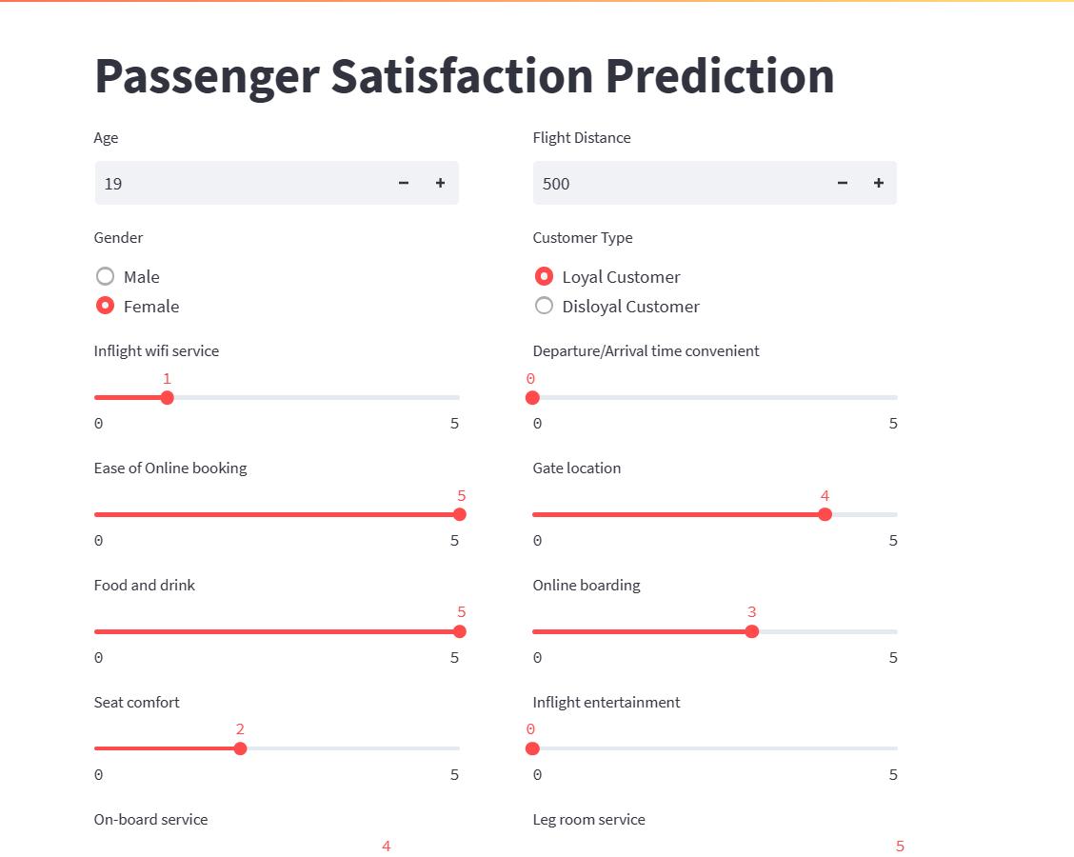
Expected Output

Slide 15
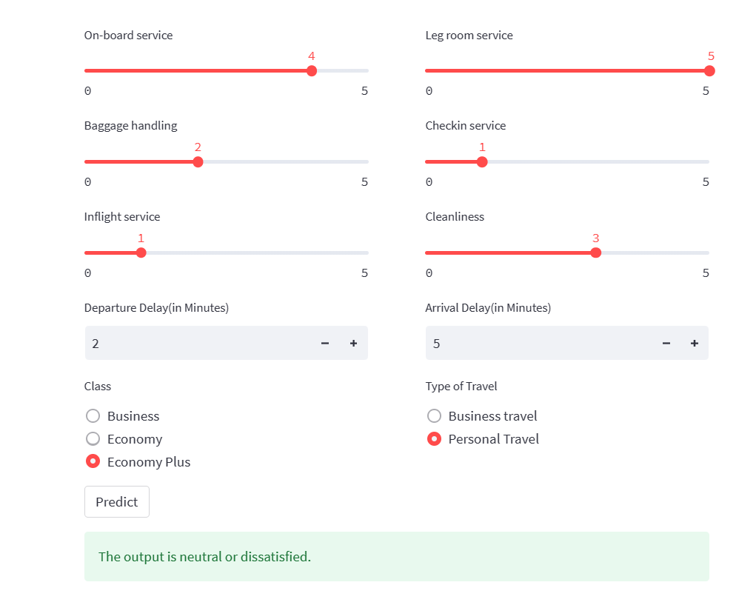
Expected Output

Slide 16
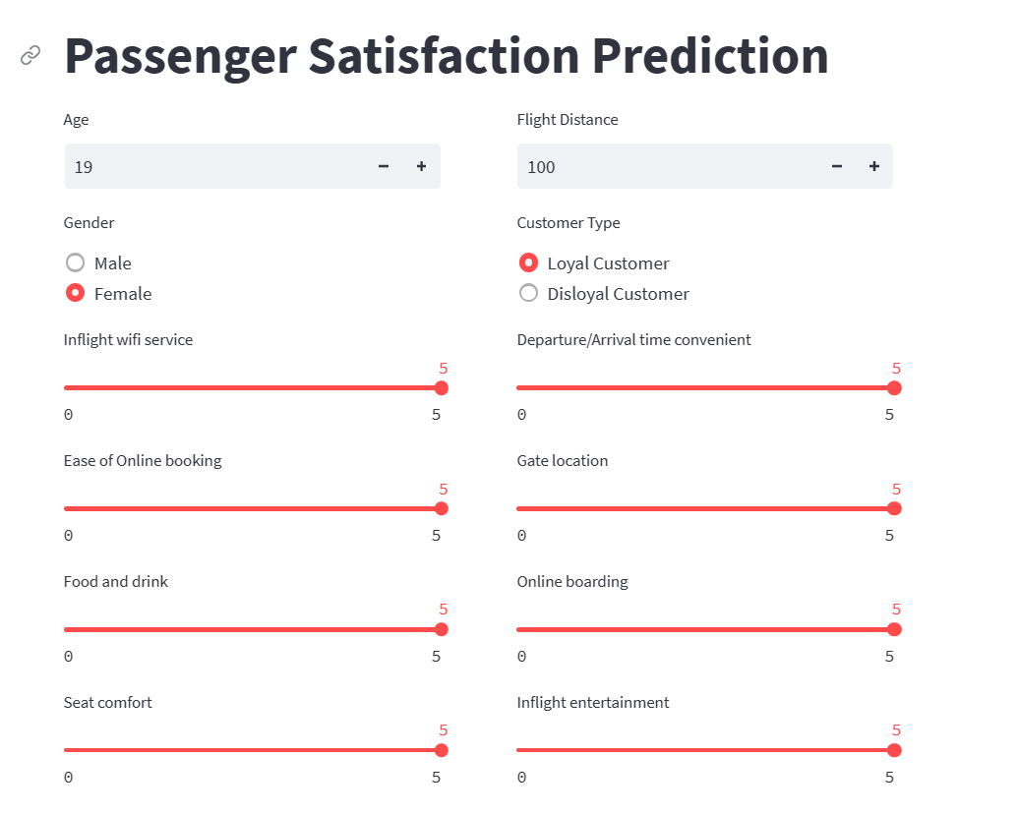
Expected Output

Slide 17
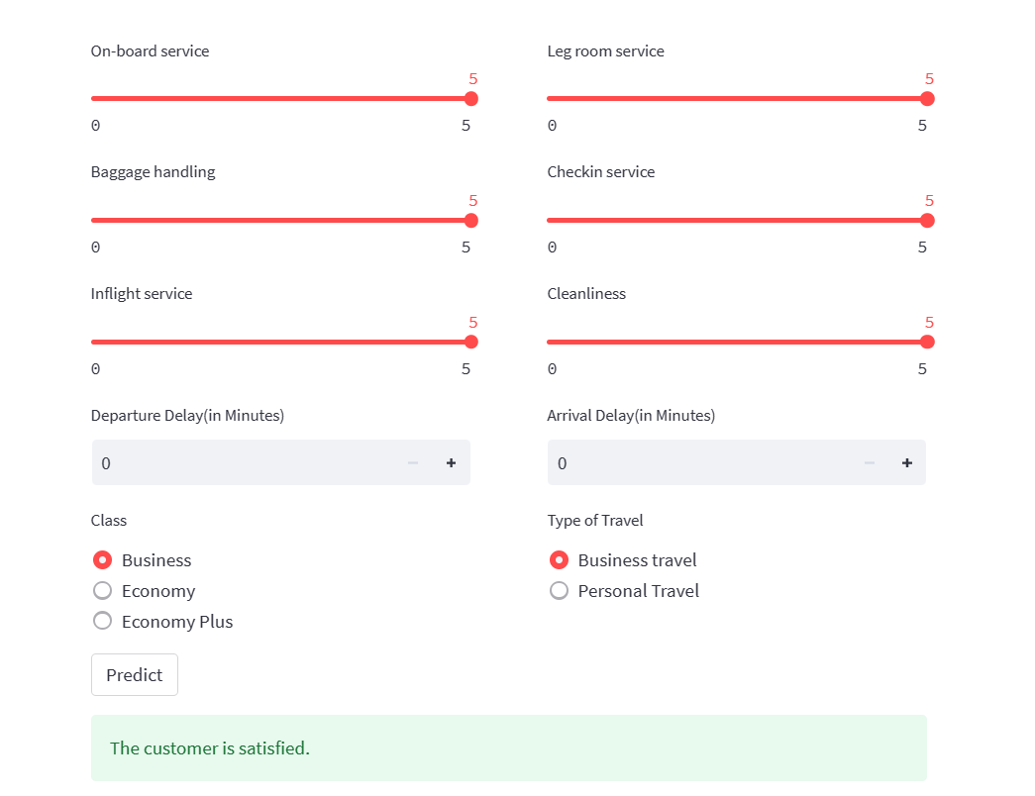
Expected Output

Slide 18
Future Scope
The future scope of airline satisfaction prediction projects is vast, and there are several potential areas of development that could shape the future of this field.
As more and more advanced machine learning algorithms are being developed, it is potentially possible that some machine algorithm would predict airline satisfaction to its maximum accuracy. This could include data from various data sources and making use of social media for better customer review.
As the technology progresses, it is possible that new chatbots may be invented that would predict the airline satisfaction by using advanced features like natural language processing and sentiment analysis. This would definitely make the process faster and easier.
Predictive analytics could also play a greater role in airline satisfaction prediction projects in the future, with airlines using data analytics to anticipate customer needs and preferences, and to provide personalized recommendations and offers.

Slide 19
Conclusion
Predicting airline satisfaction is a complex task that requires analyzing a variety of factors, including flight punctuality, onboard amenities, customer service, ticket prices, and overall travel experience. Machine learning algorithms can be trained on historical data to identify patterns and make predictions about future customer satisfaction levels.
Additionally, the project might provide insights into the factors that contribute to airline satisfaction, which could be used by airlines to improve their services and increase customer satisfaction.
It's important to note that customer satisfaction can be subjective and vary greatly between individuals. Therefore, predicting satisfaction levels with 100% accuracy is not always possible. However, by using advanced data analytics and machine learning techniques, airlines can gain valuable insights into their customers' preferences and expectations, allowing them to improve their services and ultimately enhance the overall travel experience for passengers.

Slide 20
References
Hosseini, S., & Ansari, S. (2019). Airline customer satisfaction prediction using machine learning algorithms. Transportation research part C: emerging technologies, 107, 282-296.
O'Neill, M., & Palmer, A. (2020). Predicting passenger satisfaction: An examination of airline websites and online reviews. Journal of Air Transport Management, 82, 101774.
Park, Y., Kim, J., & Kim, K. (2018). Predicting passenger satisfaction with airline services: The case of low-cost carriers. Journal of Air Transport Management, 71, 34-41.
Sharma, A., & Datta, S. (2018). A machine learning approach for predicting airline customer satisfaction. Journal of Air Transport Management, 67, 169-180.
Wang, Y., Chen, K., Chen, M., & Liu, C. (2019). Airline customer satisfaction prediction based on SVM and gradient boosting decision tree. Journal of Ambient Intelligence and Humanized Computing, 10(1), 253-264.

